Slide 1
COMP 262 | PHASE 1 DEMO
TEAM 2
Manav Chaudhary
Harsh Eary
Steven Hao Gong
Rishi Goyal
Parth Kishorbhai Kevadiya
Jasdish Singh
Sentiment Analysis of Amazon All Beauty Reviews
Lexicon models: VADER and TextBlob
Centennial College | November 5, 2026
Notes:
Speaker: Rishi Goyal (about 20 seconds)
- Introduce Team 2 and the six members.
- Topic: sentiment of Amazon All Beauty reviews using two lexicon models, VADER and TextBlob.
- Talk order: Manav and Rishi (data and exploration), Steven and Harsh (pre-processing and lexicons), Parth and Jasdish (results, conclusion and live demo).

Slide 2
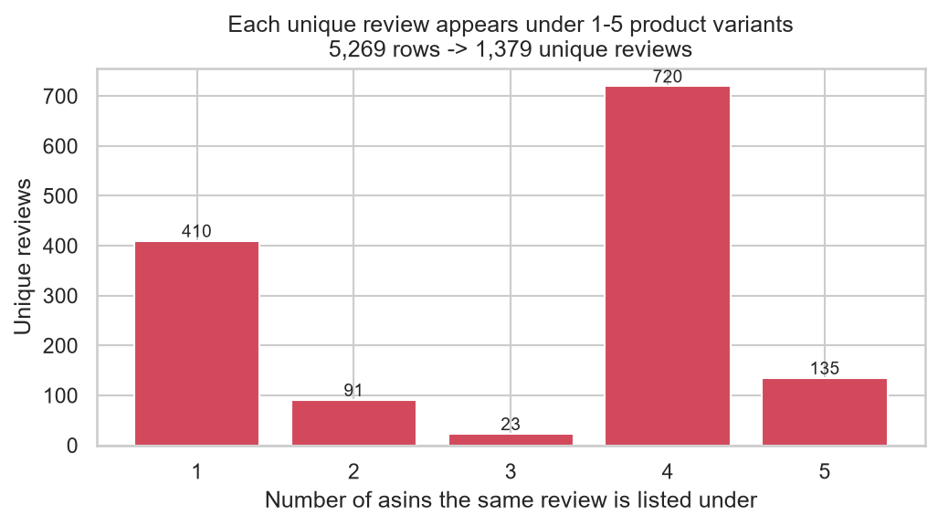
Dataset and Duplicates
5,269
rows: 85 products, 991 reviewers
73.8%
are copies across size and colour variants
1,379
unique reviews used for modelling
Amazon Review Data 2018, All Beauty 5-core (Ni, Li and McAuley, UCSD)
Notes:
Speaker: Manav Chaudhary (exploration and pre-processing pair)
- Source: Amazon Review Data 2018, All Beauty 5-core. 5,269 rows, 12 columns, 85 products, 991 reviewers, average rating 4.77.
- Key finding: 3,890 rows (73.8%) are the same review copied under different size or colour variants of a product.
- We kept one copy (same reviewer + text + timestamp), leaving 1,379 unique reviews. All modelling uses these.
- Chart: how many variants each review is copied to.

Slide 3
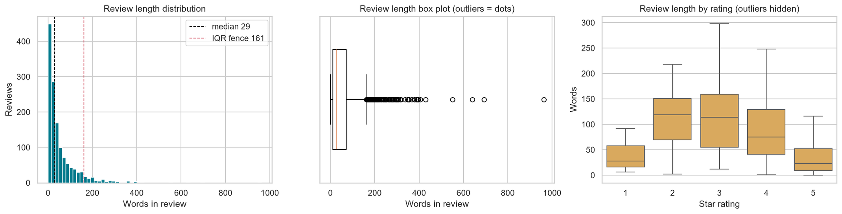
Exploration Findings
91%
62.5%
86%
29 words
positive, so macro-F1 is the main metric
of reviews are in just 2 products
of users wrote only one review
median length; 2-3 star reviews are longest
Notes:
Speaker: Rishi Goyal (exploration and pre-processing pair)
- Labels on unique reviews: 1,259 Positive (91.3%), 64 Neutral (4.6%), 56 Negative (4.1%). Because of this imbalance, accuracy is misleading, so macro-F1 is our main metric.
- Products: median 4 reviews each, but 2 products hold 62.5% of reviews.
- Users: 86% wrote only one unique review.
- Length: median 29 words, 106 long outliers above the 161-word fence (kept). Mixed 2-3 star reviews are the longest.
- Chart: review length, outliers and length by rating.

Slide 4
Pre-processing
Labels: 4-5 Positive (91.3%) | 3 Neutral (4.6%) | 1-2 Negative (4.1%)
Input: review text + summary. Removed duplicates and auto-generated "Five Stars" titles (they leak the label).
VADER: light cleaning
TextBlob: full cleaning
• Remove HTML, URLs, repeated letters
• Keep case, punctuation, stop words
• CAPS and "!" are sentiment signals
• Lower-case, expand contractions
• Drop stop words, keep "not"
• Lemmatise to base words
TextBlob macro-F1 on 378 dev reviews: 0.460 → 0.506
Notes:
Speaker: Steven Hao Gong (lexicon study and per-model cleaning pair)
- Labels come from stars: 4-5 Positive, 3 Neutral, 1-2 Negative.
- Input is reviewText + summary. We removed duplicate copies, 1 empty review, and auto-generated "Five Stars" titles because they repeat the rating and leak the label. Short and long reviews were kept.
- Each lexicon gets its own cleaning. VADER reads CAPS, punctuation and "!", so it only gets light cleaning. TextBlob matches base words, so we lower-case, expand contractions, drop stop words but keep negations, and lemmatise.
- On 378 held-out reviews this raised TextBlob macro-F1 from 0.460 to 0.506. Removing "not" hurt both models.

Slide 5
Models: VADER vs TextBlob
VADER
TextBlob
• Rated word list + grammar rules
• Handles negation, CAPS, "!!!", "but"
• Pos ≥ 0.05, Neg ≤ -0.05
• Tuned: ±0.40
• Averages adjective scores
• Flips polarity on negation
• Pos > 0, Neg < 0
• Tuned: Pos ≥ 0.075, Neg ≤ 0.05
Rejected SentiWordNet: it scores "not good" as positive
Test: 1,000 random unique reviews (911 Pos, 51 Neu, 38 Neg). Thresholds tuned only on the other 378.
Notes:
Speaker: Harsh Eary (lexicon study and per-model cleaning pair)
- We studied three lexicons: VADER, TextBlob and SentiWordNet.
- VADER: rated word list plus grammar rules. It handles negation, CAPS, "!!!", emoticons and "but". Compound score from -1 to +1. Positive if >= 0.05, Negative if <= -0.05, otherwise Neutral.
- TextBlob: averages adjective polarity scores and flips them on negation. Positive if > 0, Negative if < 0.
- SentiWordNet was rejected: no negation rules, so "not good" comes out positive.
- Evaluation: a fixed random sample of 1,000 unique reviews (seed 42). The remaining 378 reviews were used only to tune thresholds, so the test set stays unseen.

Slide 6
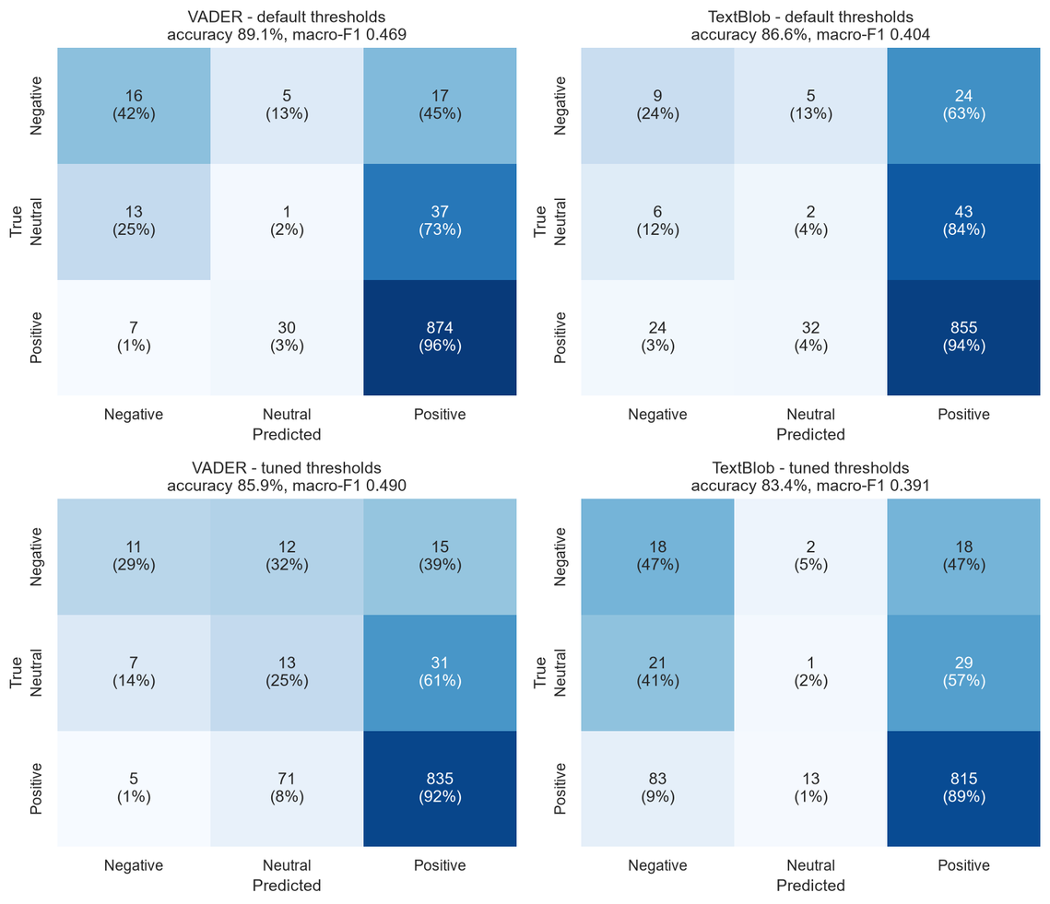
Results
Macro-F1 on 1,000 test reviews
0.469
VADER (tuned 0.490)
0.404
TextBlob
0.318
Always Positive baseline
• Neutral is mostly predicted Positive (73% VADER, 84% TextBlob)
• Accuracy drops from 95% (11-30 words) to 74% (150+ words)
Notes:
Speaker: Parth Kishorbhai Kevadiya (models and validation pair)
- Macro-F1 is the main metric because 91% of reviews are positive. The Always Positive baseline already gets 0.911 accuracy but only 0.318 macro-F1.
- VADER (default): accuracy 0.891, macro-F1 0.469, F1 Negative 0.432. It finds far more negative reviews than TextBlob.
- TextBlob (default): accuracy 0.866, macro-F1 0.404, F1 Negative 0.234.
- Tuning (on the 378 dev reviews): VADER at +/-0.40 rises to 0.490 macro-F1 and Neutral F1 0.177. Tuning did not help TextBlob (0.391).
- Confusion matrices: neutral reviews are mostly predicted Positive (73% VADER, 84% TextBlob).
- Long reviews are harder: accuracy falls from 95% (11-30 words) to 74% (150+ words).

Slide 7
Conclusion and Phase 2
01
02
03
De-duplication was essential
VADER is the better lexicon
Both miss neutral and mixed reviews
74% of rows were copies
Macro-F1 0.469 vs 0.404
73-84% predicted Positive
PHASE 2
Machine learning, recommender and LLM tasks
Evaluated on the same 1,000 test reviews, so results compare directly
Notes:
Speaker: Jasdish Singh (models and validation pair)
- Takeaway 1: de-duplication was essential. 74% of rows were copies, and keeping them would have inflated every count.
- Takeaway 2: VADER is the better lexicon for these reviews (macro-F1 0.469 vs 0.404) and finds far more negative reviews.
- Takeaway 3: both lexicons miss neutral and mixed reviews (73-84% of neutral predicted Positive), and long reviews are harder.
- Assumptions: the star rating is the true sentiment; same reviewer + text + timestamp = same review.
- Phase 2: machine-learning models, a recommender and LLM tasks, tested on the same 1,000 reviews so we can compare directly with these lexicon results.

Slide 8
Thank you. Questions?
Notes:
Live demo: Parth runs the script, Jasdish narrates (about 1 minute). All six members take questions.
- Run: python team2_phase1_lexicon_sentiment.py (seed 42, downloads the data itself).
- Point out as it runs: duplicate removal (5,269 to 1,379), label counts, the 1,000 / 378 split, and the final results table.
- Open figures/13_confusion_matrices.png and results/run_log.txt if time allows.
- Likely questions: why macro-F1 (91% positive data), why not SentiWordNet (no negation), why neutral fails (mixed wording, mostly positive words), what Phase 2 adds (machine learning trained on our labels).

